Slide 1


Password Hashing and Graph Pebbling
SAMSON ZHOU
Joint work with:
Jeremiah Blocki
Ben Harsha
Ling Ren

Slide 2


Slide 3
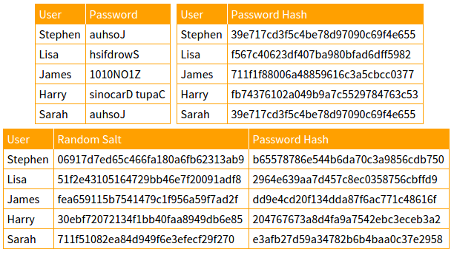

Slide 4












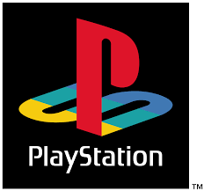


Slide 5
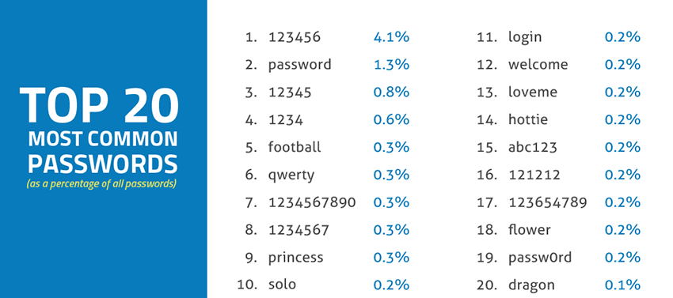
Source: SkyHigh

Slide 6

Economics of Password Cracking
Develop a new game theoretic framework to quantify the damage of an offline attack
Show that Yahoo! leaked passwords (3 billion users) follow Zipfian distribution
Analysis on a Zipfian distribution with estimated black market password costs
CONCLUSION: Any rational and economic adversary are compelled to crack ALL passwords under current standard password parameters.

Slide 7
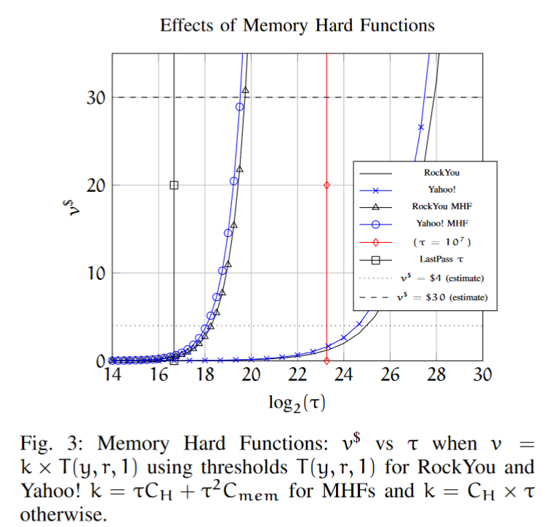
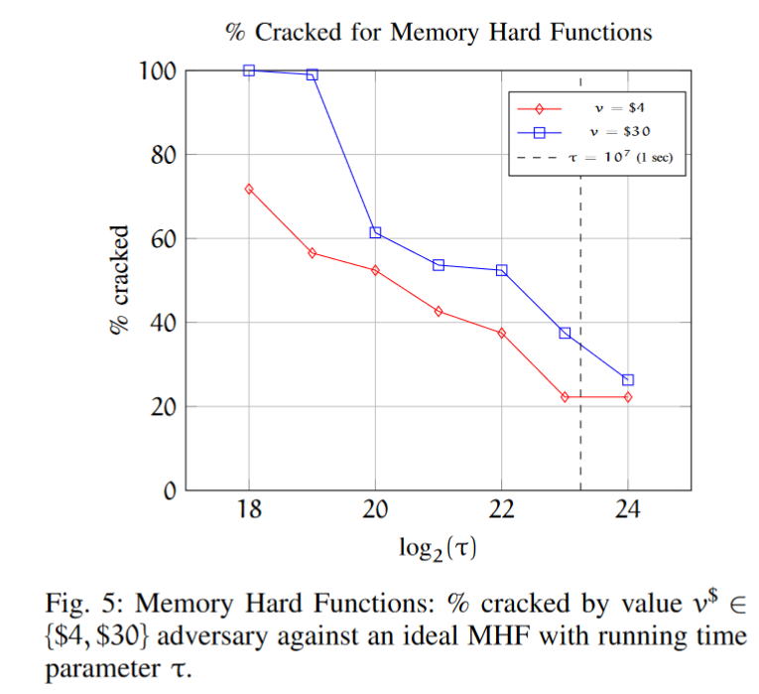
Memory Hard Functions

Slide 8
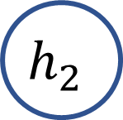
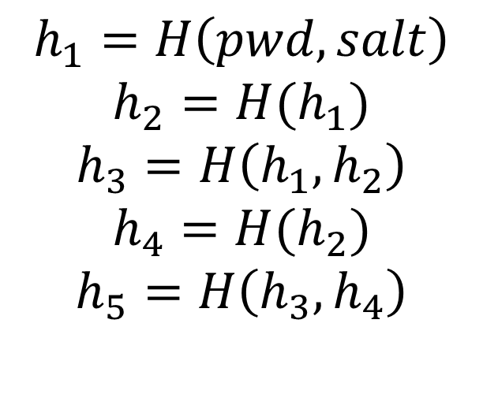

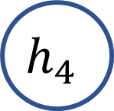
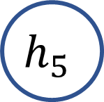

Memory Hard Functions
$$h_{1}=H\left(pwd, salt\right)$$
$$h_{2}=H(h_{1})$$
$$h_{3}=H\left(h_{1},h_{2}\right)$$
$$h_{4}=H(h_{2})$$
$$h_{5}=H\left(h_{3},h_{4}\right)$$
pwd
$$h_{1}$$
$$h_{2}$$
$$h_{3}$$
$$h_{5}$$
$$h_{4}$$

Slide 9
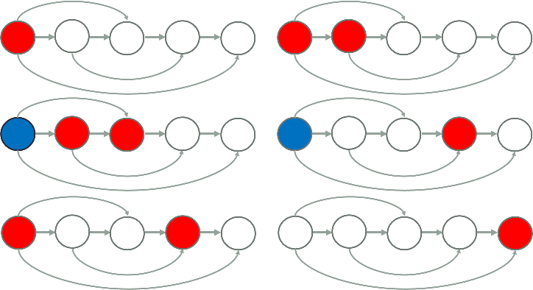

Models of Function Cost
Formalized the bandwidth cost model as a pebbling game
Bandwidth-hard vs Memory-hard
Pebbling game goal is to place a pebble at the last node. Rules:
1) Can only place red node if all parent nodes contain red nodes
2) Can swap between red and blue pebbles at a node
3) Can only have $m$ red pebbles at a time

Slide 10
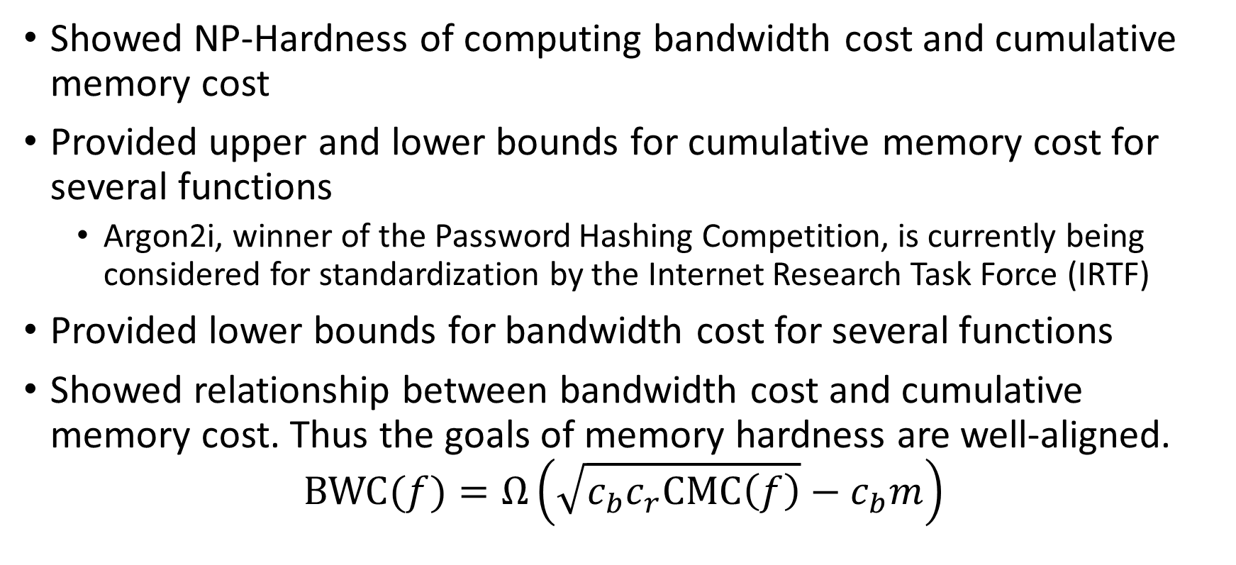
Analysis of Password Hash Functions
Showed NP-Hardness of computing bandwidth cost and cumulative memory cost
Provided upper and lower bounds for cumulative memory cost for several functions
Argon2i, winner of the Password Hashing Competition, is currently being considered for standardization by the Internet Research Task Force (IRTF)
Provided lower bounds for bandwidth cost for several functions
Showed relationship between bandwidth cost and cumulative memory cost. Thus the goals of memory hardness are well-aligned.
$$BWC(f)=Ω\left(\sqrt{c_{b}c_{r}CMC\left(f\right)}−c_{b}m\right)$$

Slide 11
References
Jeremiah Blocki, Ben Harsha, Samson Zhou. On the Economics of Offline Password Cracking. IEEE Security and Privacy (S&P, Oakland) 2018
Jeremiah Blocki, Ling Ren, Samson Zhou. Bandwidth-Hard Functions: Reductions and Lower Bounds. Manuscript
Jeremiah Blocki, Samson Zhou. On the Computational Complexity of Minimal Cumulative Cost Graph Pebbling. Financial Cryptography and Data Security (FC) 2018
Jeremiah Blocki, Samson Zhou. On the Depth-Robustness and Cumulative Pebbling Cost of Argon2i. 15th IACR Theory of Cryptography Conference (TCC) 2017

Slide 12


